Slide 1
Photosynthesis

Slide 2
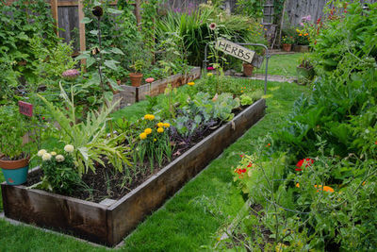
Most plants don't eat food like you or me.
Instead, they make the food that they need in a process called photosynthesis.
Photosynthesis uses water, the sun, and the air to produce glucose (C₆​H₁₂​O₆​).
Glucose is food for plants. It gives them the energy they need to grow.

Slide 3
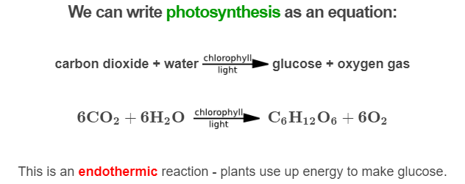

Slide 4
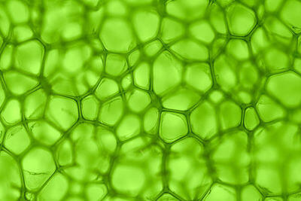
What we see from the reaction is that sunlight and chlorophyll help turn carbon dioxide and water into glucose and oxygen.
Chlorophyll is the chemical which makes the energy of the sun usable for this reaction. It is also the chemical which makes plants green.

Slide 5
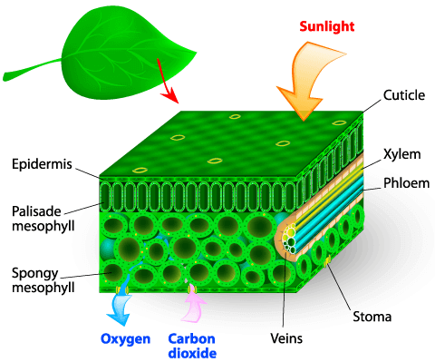
Let's briefly go over the structure of a leaf.
Photosynthesis takes place in chloroplasts, which are located in the palisade cells near the top of a leaf.
It happens here because chlorophyll is held in the chloroplasts. All other ingredients for the reaction are moved into the palisade cells from the outside.

Slide 6
Sunlight enters the leaf through the cuticle and epidermis.
These are protective layers on the top of the leaf which are also transparent.
So sunlight can hit the leaf and travel to the palisade cells, where chlorophyll converts it into energy.

Slide 7
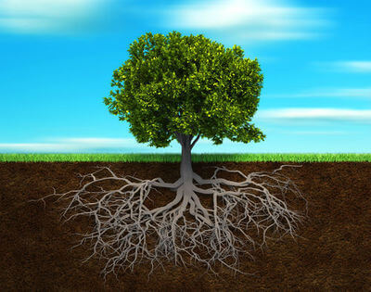
Water is taken in from the roots, and moves through the leaves in their veins.
From the veins, it travels into the palisade cells for use in the photosynthesis reaction.

Slide 8
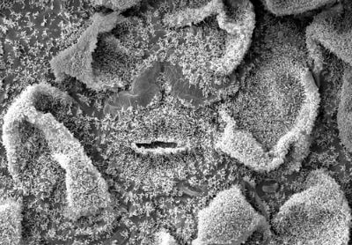
The bottom of the leaf has openings called stomata which allow gases to pass through them.
This happens by diffusion: Gases move from areas of high concentration to low concentration.
So gases with lower concentration inside than outside will move through the stomata into the leaf.

Slide 9
Stomata and diffusion are how carbon dioxide enters leaves.
CO₂​ is used up inside the leaf so the concentration is low.
Diffusion brings carbon dioxide through the stomata and continues to push it into the palisade cells, where it can be used in photosynthesis.

Slide 10
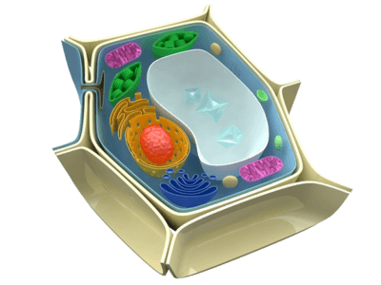
Photosynthesis produces oxygen and glucose.
The glucose is transported to plant cells to be used as food, and some of the oxygen is as well.
The rest of the oxygen exits the leaf via diffusion, as the oxygen concentration in a leaf is higher than the air outside.

